Slide 1
The Quantum Solution
QUANTUM KEY DISTRIBUTION
Made by: Hamzeh Al Ameen, Tayma Al Dabbas, Dion Ismajli
Made by:

Slide 2

The Quantum Threat:
Why Math-Based Encryption Fails
The Quantum Solution
Quantum Key Distribution (QKD): creates secret keys using photons.
Any eavesdropping attempt changes the qubits and is instantly detected.
Security becomes guaranteed by physics, not by computation time.
The Problem with Classical Encryption
RSA and ECC rely on math problems that are hard for classical computers.
Quantum computers can solve those problems easily with Shor’s algorithm.
Once large-scale quantum hardware exists, current encryption becomes obsolete.
We need security that’s physically guaranteed, not just computationally hard.
Notes:
“Our current encryption, like RSA and ECC, relies on math problems that classical computers can’t solve in a reasonable time.
But quantum computers, using Shor’s algorithm, can solve those same problems exponentially faster — which means that once we have scalable quantum hardware, today’s encryption will no longer be secure.
The solution is to use quantum mechanics itself to protect our data.
Quantum Key Distribution, or QKD, sends secret keys through photons — and if anyone tries to intercept them, the physics changes the particles, revealing the attack immediately.”

Slide 3


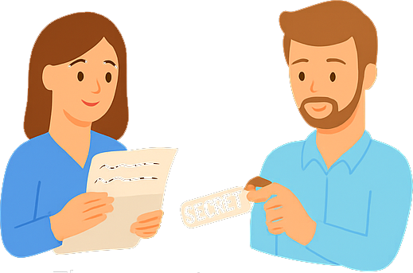

How Quantum Key Distribution Works
The act of looking at the message disturbs the photons, leaving clear signs of tampering.
Alice creates a quantum message. She writes her message using quantum ink light particles (photons) that change if anyone tries to read them.
Alice and Bob compare notes
If the message arrives untouched, they share a matching secret key.
If not, they discard it and try again, physics reveals the spy.
Notes:
In quantum key distribution, information is encoded into photons — tiny particles of light — each carrying a bit of data in a fragile quantum state.
If someone tries to intercept or measure those photons, the act of observation itself disturbs them, because of the uncertainty principle.
When the sender and receiver compare parts of their data, any disturbance immediately reveals that the channel wasn’t secure.
If no interference is detected, they keep the remaining data as a shared secret key — one guaranteed safe by the laws of physics, not by computational strength.

Slide 4
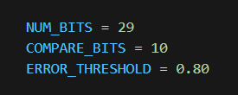
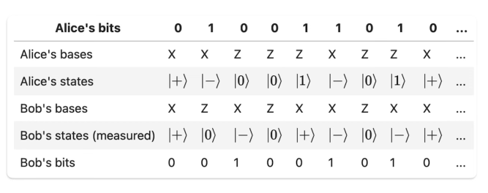
CONTROLLABLE
VARIABLES

Slide 5
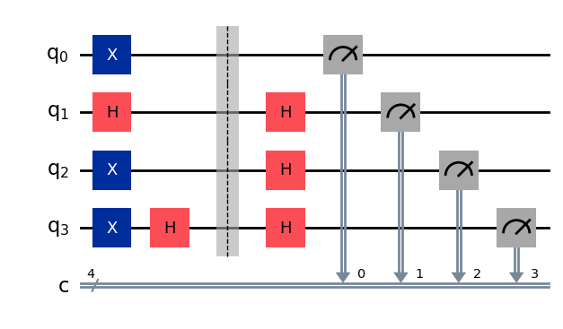
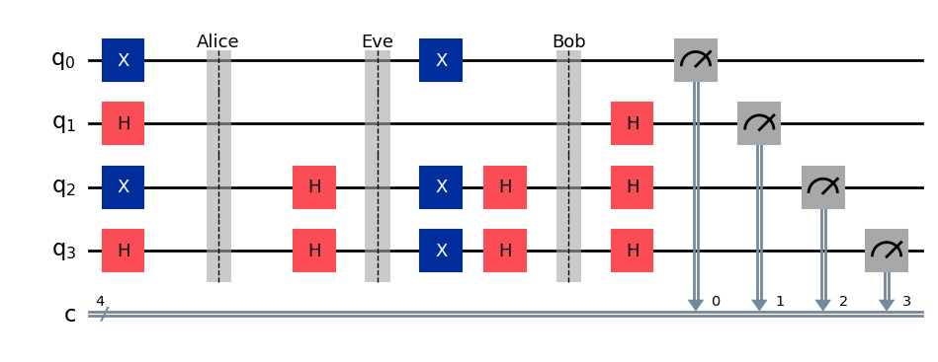
VISUALIZING
EAVESDROPPING

Slide 6
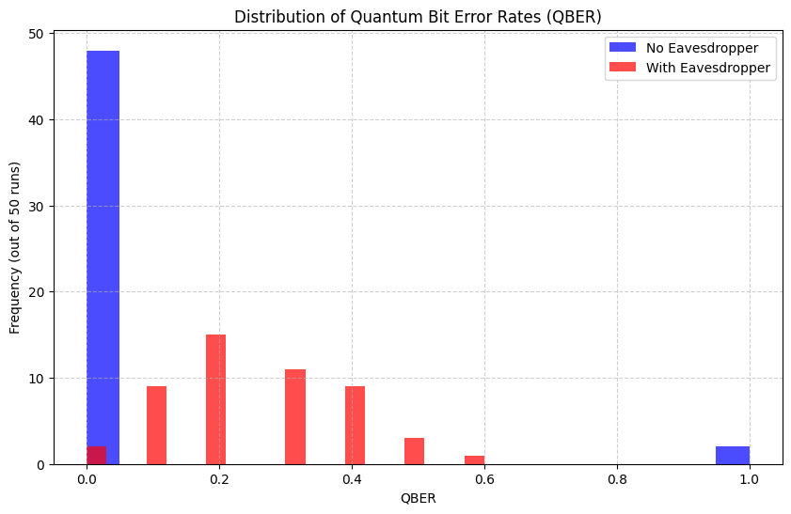
ERROR RATES
DEPENDING
ON THE
EAVESDROPPER

Slide 7

PRIVACY AMPLIFICATION
1010101011100
LENGTH = L
COMPRESSION
RATIO
PUBLIC
10010111100
LENGTH = L’

Slide 8


COMPARISONS
AND LIMITATIONS
BB84
MDI-QKD
VS
Notes:
Both BB84 and MDI-QKD are quantum key distribution protocols, but they resist attacks in different ways.
BB84 relies purely on quantum physics. If an attacker tries to intercept the photons, their measurement changes the quantum state — and we immediately detect that disturbance through an increased error rate. It’s perfectly secure in theory, but in practice, it’s vulnerable to side-channel detector attacks cases where hackers exploit imperfections in photon detectors.
Measurement-Device-Independent QKD doesn't reveal the key because it sends quantum signals to an untrusted third party, Charlie, who performs a measurement but doesn't know the contents of the signals. Alice and Bob can then publicly compare their measurement results to see if they are correlated, and if they are, they can distill a secret key from those correlated bits, even if Charlie was malicious.
So in essence, BB84 detects eavesdropping, while MDI-QKD blocks it entirely — turning theoretical quantum security into practical, attack-proof communication.

Slide 9
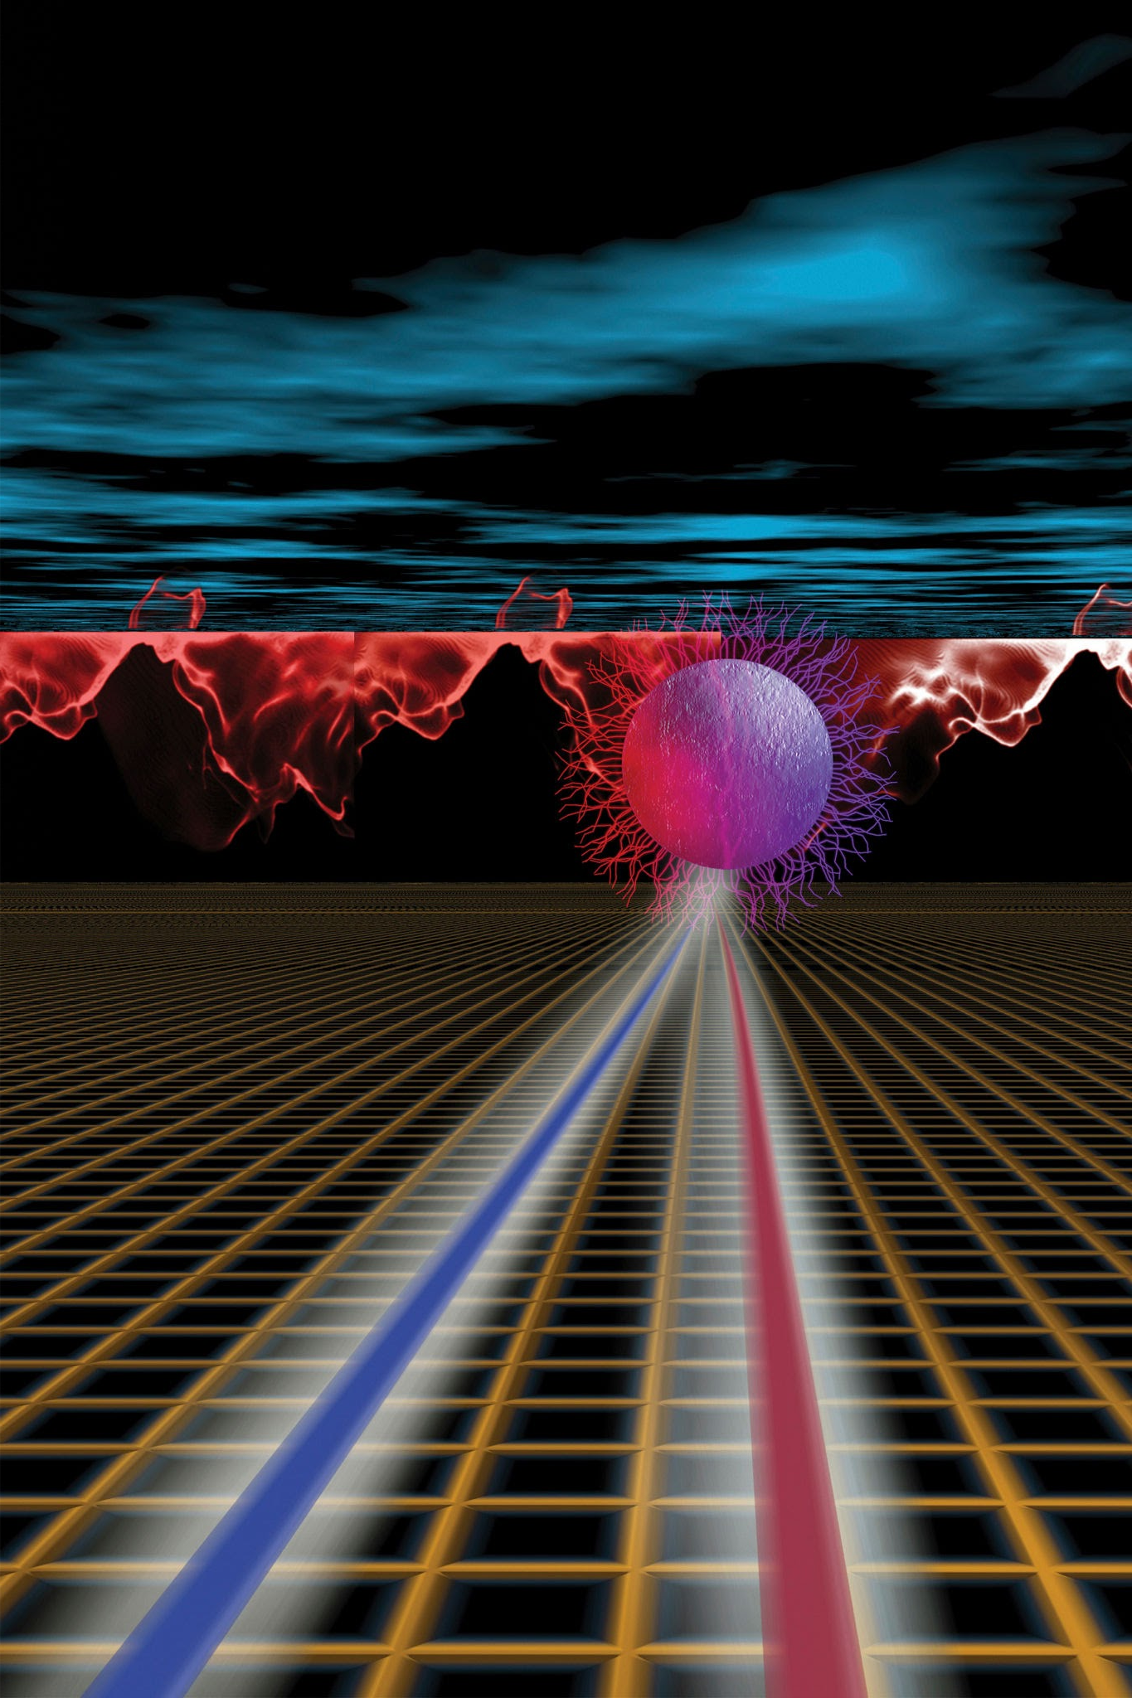
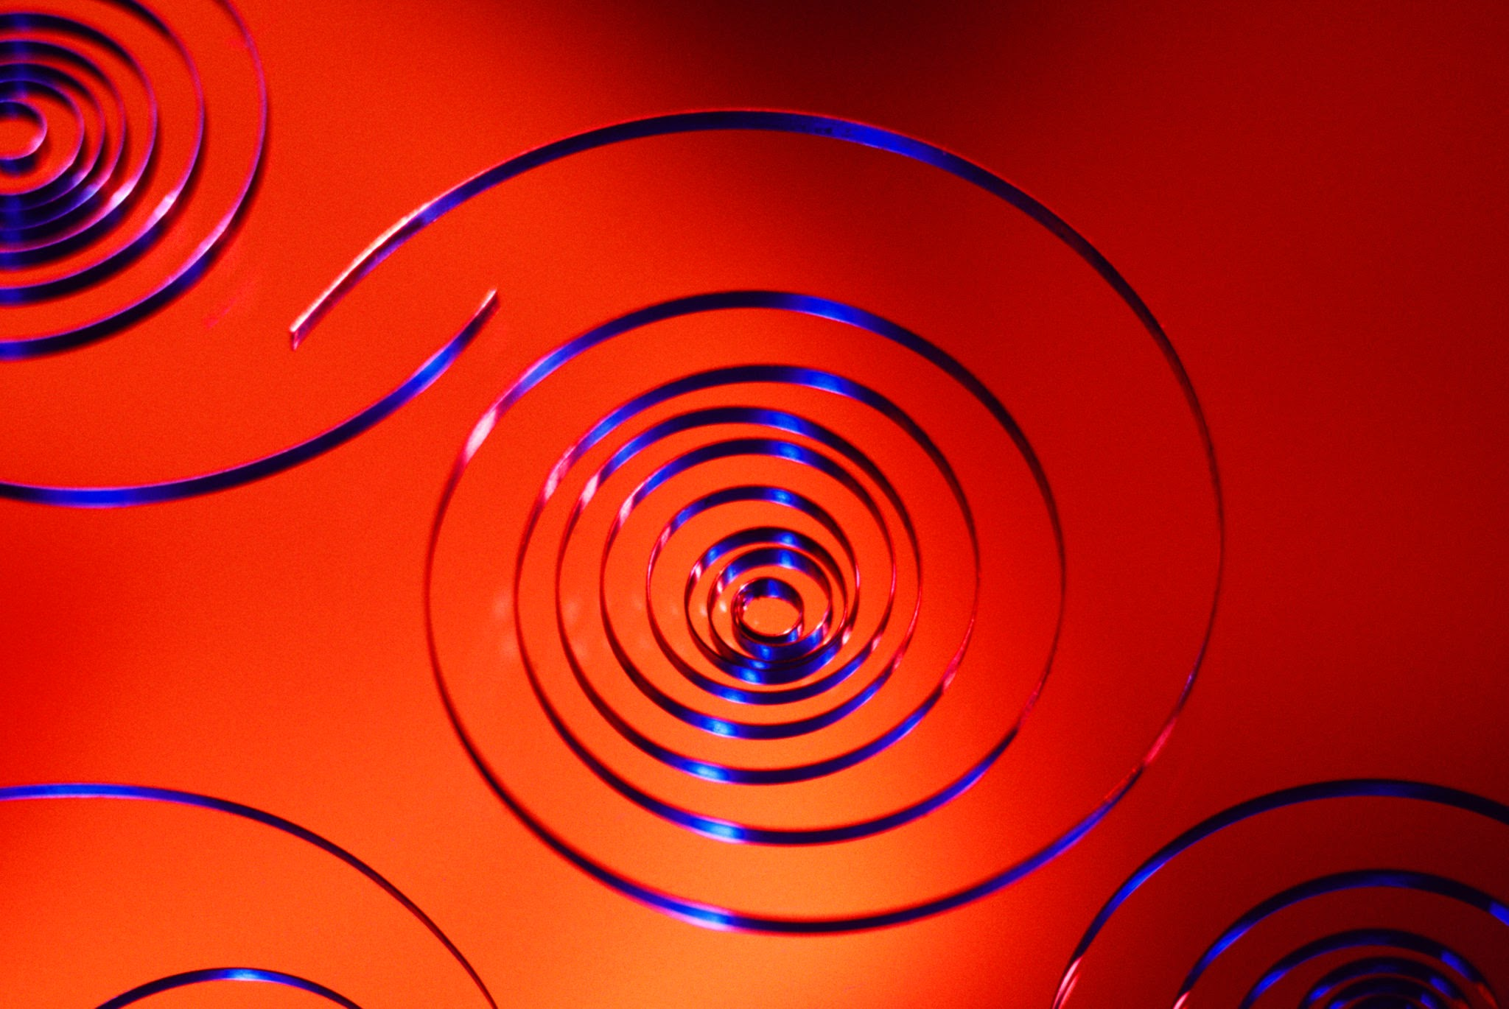
Quantum Security: The Next Digital Revolution
The future of encryption isn’t harder math it’s quantum light.
Notes:
Privacy Amplification (PA) is the crucial step that makes this ITS guarantee possible.
A QKD system without Privacy Amplification is incomplete and fundamentally fails to deliver the promised level of perfect, future-proof security.
A system that only performs the quantum transmission (BB84) and the error check (QBER) results in a key that is not perfectly secret.
Privacy Amplification is the bridge that converts the physical security promised by the quantum channel into the Information-Theoretic Security required for QKD's long-term success and ultimate value proposition. Without it, the system loses its unique claim of perfect security.

Slide 10
THANK
YOU!
May you have a beautiful night

